Slide 1
2023 WIFI Module Customers CRD Summary Report
Stop
Customers confidential information under NDA, Intel internal use only
Rev2.0, CQ&R CMEE Team, 2023Q2

Slide 2

General SMT Line Layout
Post-Reflow Automated Optical Inspection (AOI)
Pre-Reflow Automated Optical Inspection (AOI) - Optional
Solder Paste Inspection (SPI)

Slide 3
Objectives
Share Findings From CMEE Mobile Industry Data Collection (WIFI Module Customer Survey)
Data Collected From 10 ODM Customers/Sites
  Compal (KunSan – Build for Dell/HP, ChengDu – Build for Dell, ChongQing – Build for Acer)
  HuaQin (Build for HuaWei/Asus/Lenovo/Samsung)
  Inventec ChongQing (Build for HP/Asus)
  LCFC (Build for Lenovo)
  MSI KunSan (Own Brand)
  Pegatron (Suzhou – Build for Microsoft, ChongQing – Build for Asus)
  Quanta (ChongQing – Build for HP)

Slide 4
Highlights
Most of the customers follow Intel MAS to design land pattern and stencil.
4 mil is most popular stencil thickness, half of the customers use step-stencil on mother board WLAN SD1216 location.
Most of the customers locate the module in corner or edge. No preference on top or bottom
Only Compal CQ and HuaQin scan the SN# and save to database, and only Compal CQ’s scanner has ECC feature.

Slide 5
WIFI Module (1 Of 4)
Are you following recommended WLAN SD1216 land pattern in MAS? If not, why?
Compal CD | Compal CQ | Compal KS | HuaQin | Inventec CQ
Yes | Yes | Yes | Yes | Yes
LCFC | MSI | Pega CQ | Quanta CQ | Pega SZ
No, used to have solder open and short failures | Yes | Yes | Yes | Yes
Are you following recommended stencil opening for WLAN SD1216 in MAS?
Compal CD | Compal CQ | Compal KS | HuaQin | Inventec CQ
Yes | Yes | Yes | Yes | Yes
LCFC | MSI | Pega CQ | Quanta CQ | Pega SZ
No, used to have solder open and short failures | Yes | Yes | Yes | Yes
Most of the customers follow Intel MAS to design land pattern and stencil.

Slide 6
WIFI Module (2 Of 4)
What is the preferred stencil thickness for WLAN SD1216?
Compal CD | Compal CQ | Compal KS | HuaQin | Inventec CQ
4 mil | 5 mil | 4 mil | 4 mil | 4 mil
LCFC | MSI | Pega CQ | Quanta CQ | Pega SZ
4 mil | 4 mil | 4 mil | 4 mil | 4 mil
Is there a stencil thickness stepping up or down on mother board WLAN SD1216 location?
Compal CD | Compal CQ | Compal KS | HuaQin | Inventec CQ
Yes | Yes | Yes | No | No
LCFC | MSI | Pega CQ | Quanta CQ | Pega SZ
No | No | Yes | Yes | Yes
Most of the customers use 4 mil stencil, half of the customers use step-stencil on mother board WLAN SD1216 location.

Slide 7
WIFI Module (3 Of 4)
Where is the WLAN SD1216 located in your board design?
Compal CD | Compal CQ | Compal KS | HuaQin | Inventec CQ
Edge | Edge, center | Edge | Edge | Edge
LCFC | MSI | Pega CQ | Quanta CQ | Pega SZ
Edge | Corner | Edge | Edge | Edge or corner
Do you place the WLAN SD1216 on top (1 time reflow) or bottom (2 times reflow) side of the motherboard?
Compal CD | Compal CQ | Compal KS | HuaQin | Inventec CQ
Both | Top | Bottom | Bottom | Bottom
LCFC | MSI | Pega CQ | Quanta CQ | Pega SZ
Bottom | Bottom | Bottom | Top | Both
Most of the customers locate the module in corner or edge. No preference on top or bottom

Slide 8
WIFI Module (4 Of 4)
Do you scan the SN# of Intel SDWLAN module, and link it with board SN# and save it into your database?
Compal CD | Compal CQ | Compal KS | HuaQin | Inventec CQ
No | Yes | No | Yes | No
LCFC | MSI | Pega CQ | Quanta CQ | Pega SZ
No | No | No | No | No
If yes, is your scanner having Error correction code (ECC) feature?
Compal CD | Compal CQ | Compal KS | HuaQin | Inventec CQ
NA | Yes | NA | No | NA
LCFC | MSI | Pega CQ | Quanta CQ | Pega SZ
NA | NA | NA | NA | NA
Only Compal CQ and HuaQin scan the SN# and save to database, and only Compal CQ’s scanner has ECC feature.

Slide 9
Solder Paste Related(1 Of 2)
Can you provide your current SAC solder paste list with percent and usage?
Compal CD | Compal CQ | Compal KS | HuaQin | Inventec CQ
YunNan Tin：YW9-3005-98CY04,100% | Shenmao PF606-P 100% | Shenmao PF606-P, 50%/ YunNan TinYW9-3005-98CY04, 50% | ShenMao PF606-P, 73%;Eunow EUP-100F,27% | ShenMao PF606-P, 50% tamura LTF-204-93IVT,50%
LCFC | MSI | Pega CQ | Quanta CQ | Pega SZ
Shenmao 95% | KOKI S3X58-M406-3,100% | YunNan Tin YW9-3005-98US04 100% | Shenmao PF606-P,100% | Senju M705-S101HF(N4)-S4, 50% ,Eunow EUP-1000HQR: 30%
Can you provide your current/future LTS solder paste list with percent and usage?
Compal CD | Compal CQ | Compal KS | HuaQin | Inventec CQ
NA | NA | Nihon B37 100% | NA | No HVM plan, verified Eunow DW1000 and YunNan Tin YT-AB02
LCFC | MSI | Pega CQ | Quanta CQ | Pega SZ
Senju and Shenmao 90% total | NA | NA | NA | NA
Different ODMs have different SAC solder paste preference.
Most ODMs don’t have LTS experience

Slide 10
Solder Paste Related(2 Of 2)
Do you use LTS for other product except BGA? What paste do you use? What kind of product?
Compal CD | Compal CQ | Compal KS | HuaQin | Inventec CQ
NA | NA | No | NA | NA
LCFC | MSI | Pega CQ | Quanta CQ | Pega SZ
Full board LTS | NA | NA | NA | NA
What would be the tolerance limits used on the SPI machine for 0.35 mm pitch part?
Compal CD | Compal CQ | Compal KS | HuaQin | Inventec CQ
Volume:50%~180% | Volume:50%-150% | Volume:60%-160% | Volume:60%-150% | Volume:60%-140%
LCFC | MSI | Pega CQ | Quanta CQ | Pega SZ
Volume:70%-170% | No answer | Volume:50%-180% | Volume:50%-150% | Volume&Area:50%-150% Height: +2mil, -1mil
Only LCFC and Compal KS have LTS HVM experience

Slide 11
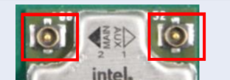
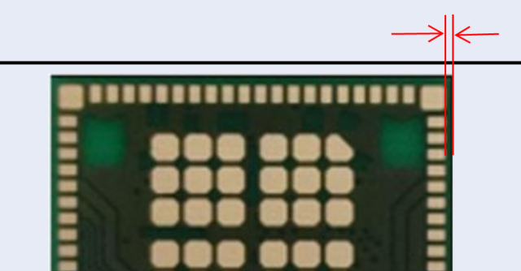
Improvement Suggestions from ODMs
Pegatron SZ:
  Change inner row pads from SMD to MD, to reduce SBB risk
  2 connectors were easy to broken
Huaqin
  Reduce the distance between the pad(outer row) and edge to facilitate the reflow

